Slide 1
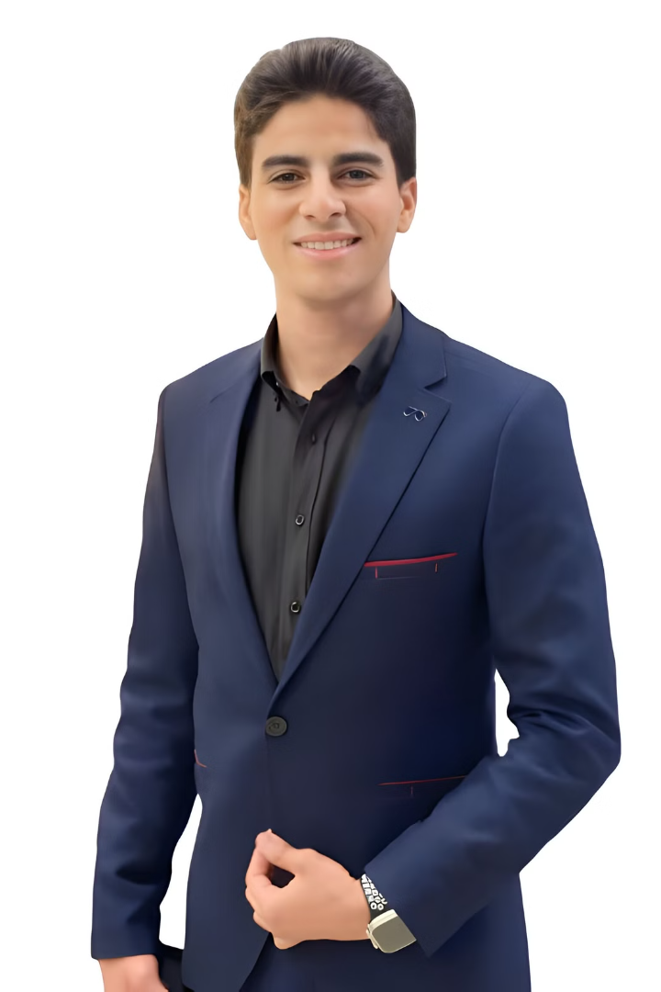
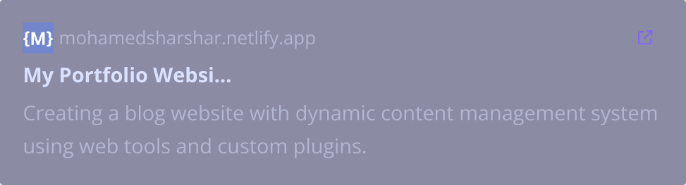
Mohamed SharShar
FullStack Web Developer

Slide 2









About Me
I am interested in the Full Stack Web Developer position at MaxedMedia, bringing three years of experience with Laravel and React. Currently at MaxedMedia, I create dynamic web applications using HTML, CSS, JavaScript, and PHP. My background in Artificial Intelligence enhances my ability to implement innovative solutions. I’m eager to contribute my skills to drive your projects forward and look forward to discussing my potential role on your team.

Slide 3


Education
MNU University Bachelor of Science in Artificial Intelligence (Expected Graduation: 2026)

Slide 4












Technical Skills
HTML
CSS
JS
PHP
MySQL
LARAVEL
PYTHON
REACT
GIT
GITHUB
BOOTSTRAP
TAILWIND

Slide 5
Work Experience
Full Stack Web Developer MaxedMedia — October,2022 to Present
Developed and maintained dynamic web applications using Laravel, React, HTML, CSS, JavaScript, and PHP.
Collaborated with marketing and development teams to create responsive, user-friendly websites, driving engagement and conversions.
Utilized MySQL for database management, writing optimized queries to improve data retrieval efficiency.
Designed and implemented front-end layouts using Tailwind CSS and Bootstrap, ensuring consistent cross-browser compatibility and responsive design.
Integrated RESTful APIs to enhance website functionality and communication between front-end and back-end systems.
Participated in code reviews and debugging processes, maintaining clean and efficient codebases.
Applied SEO principles to improve website visibility and organic search rankings for marketing projects.
Managed deployment processes and version control using Git, ensuring smooth and timely project delivery.

Slide 6
Offered Experience
Offered Service: Mokafht-Hashrat Website
Offered Service: Developed a full website for Mokafht-Hashrat, including front-end design using HTML, CSS, and JavaScript, and back-end functionality with PHP and MySQL. The site is responsive and user-friendly for pest control service clients.
Offered Service: MaxedMedia Portfolio
Offered Service: Created a professional portfolio for MaxedMedia to showcase past projects using modern frameworks like Tailwind and Bootstrap. Optimized for fast loading and seamless user experience across all devices.

Slide 7
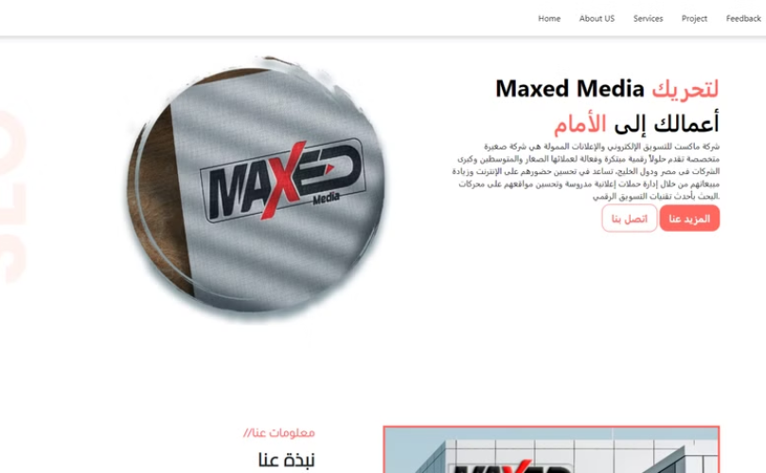

ProJects
MaxedMedia Website Portfolio 1
MaxedMedia Website Portfolio 2
Creating a blog website with dynamic content management system using web tools and custom plugins.
Designing a company's portfolio, implementing a chatbot in company website, Making automatic form for communication with company using PHP, MySQL.

Slide 8
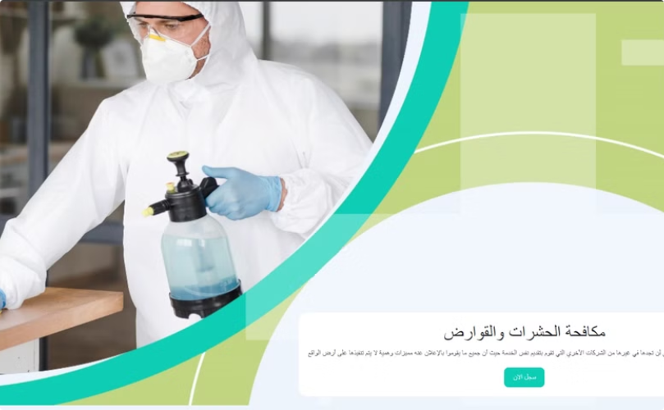
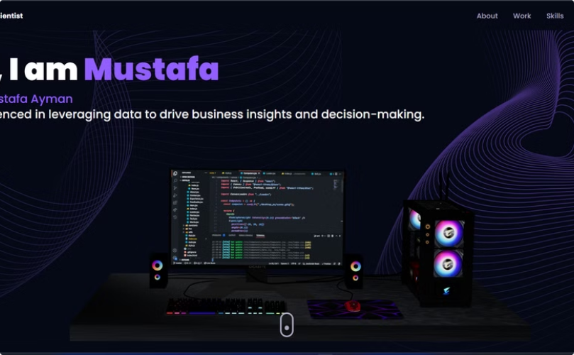
ProJects
Mokafht-Hashrat
3D Portfolio
Making specific privileges for Admin with encryption to improve security and developing a complete website according to company need.
Mustafa Ayman's portfolio, featuring his skills, projects, and contact information as a developer and designer. It highlights his technical expertise.

Slide 9
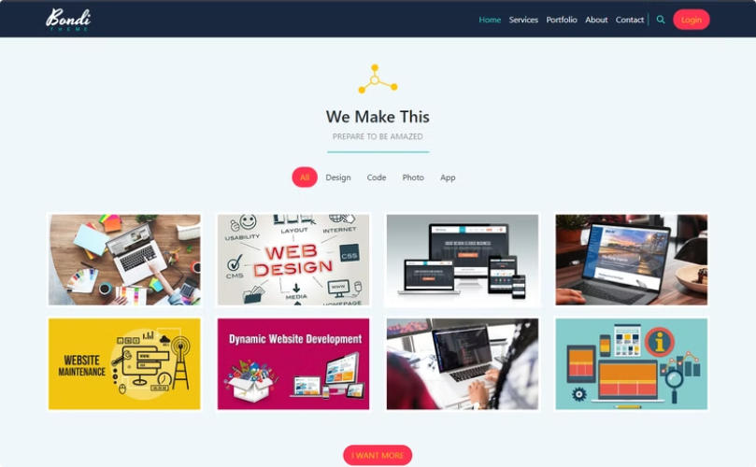
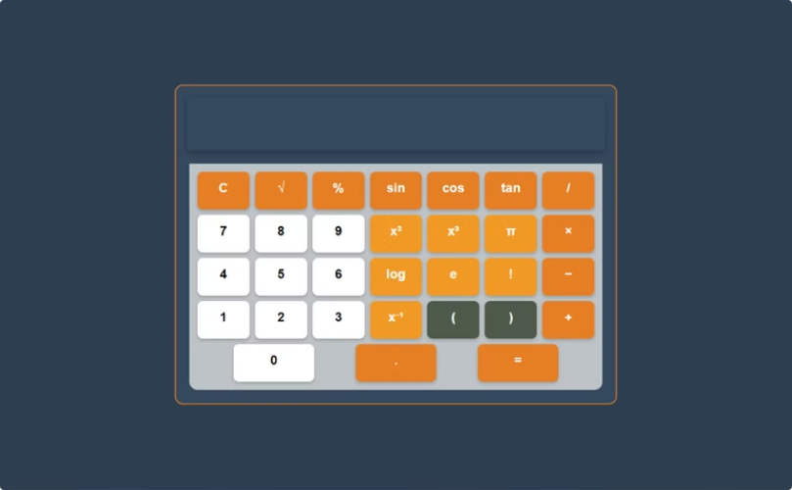
ProJects
Bondi Design Theme
Simple Calculator
Bondi is a clean, modern website theme designed for businesses, offering a professional layout with sleek design elements.
A basic yet functional calculator built using JavaScript. It allows users to perform basic arithmetic operations in a clean and user-friendly interface.

Slide 10
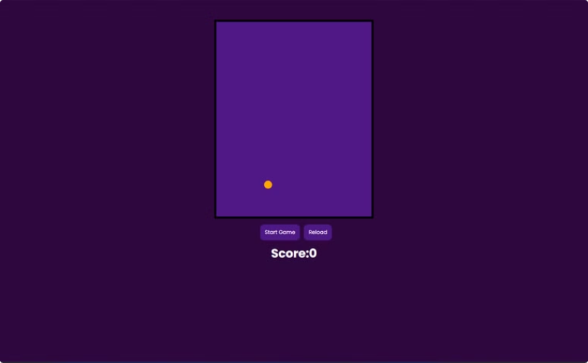
ProJects
Fall Ball Game
A fun and interactive game built using JavaScript, offering a simple yet engaging experience where users can enjoy a ball game with easy controls.

Slide 11
Achievements
1st Place in Python Competition at MNU University
Completed the National Telecom Institute (NTI) Program
Finished courses on Coursera, enhancing my technical skills
Participated in the Egypt Digital Pioneers Initiative
Completed a specialized course in Laravel
Successfully completed Google Developer Student Club (GDSC) training in The AI ​​Track
actively participated in volunteer work for MNU University, contributing to community projects and student support initiatives

Slide 12
Testimonials
Testimonials "Mohamed's dedication and passion for learning are truly impressive. His technical skills, especially in Python, are exceptional, and he consistently delivers high-quality results.“
—Dr. Ahmed Saleh, Professor of Computer Science, MNU University “Mohamed was an outstanding participant in the Egypt Digital Pioneers Initiative. His innovative approach and strong ethical work made him a valuable contributor to our projects.”
— Sarah Hassan, Program Coordinator, Egypt Digital Pioneers Initiative “Volunteering alongside Mohamed at MNU University was a pleasure. His leadership and teamwork helped our projects succeed and greatly impacted the student community.”
— Omar Nabil, Student Coordinator, MNU University

Slide 13
Contact Me
Email: mmshsh05@gmail.com
Phone: +20 100 383 1471
Website: https://mohamedsharshar.netlify.app/
LinkedIn: https://www.linkedin.com/in/mohamed-waleed-821452246/

